Slide 1
Airline Customer Satisfaction Analysis

Slide 2
Introduction
Customer satisfaction plays a crucial role in the success and growth of any business . Airlines strive to provide exceptional experiences to their passengers, ensuring their comfort, convenience, and overall satisfaction throughout their journey. Understanding the factors that influence customer satisfaction is vital for airlines to make informed decisions and improve their services.
Specifically, this notebook will focus on examining various aspects of the airline travel experience, including seat comfort, inflight services, online support, and more. By analyzing these factors, we aim to identify which aspects have the most significant impact on customer satisfaction. Furthermore, we will explore any relationships or correlations between different variables to gain a comprehensive understanding of the factors that contribute to overall satisfaction.

Slide 3
Overview of the dataset:
Satisfaction: This column represents the customer's satisfaction level with their overall flight experience. It is a categorical variable with two possible values: "satisfied" or "neutral or dissatisfied".
Gender: This column indicates the gender of the customer. It is a categorical variable with two possible values: "Male" or "Female".
Customer Type: This column categorizes the customers based on their type. It is a categorical variable with two possible values: "Loyal Customer" or "Disloyal Customer".
Age: This column represents the age of the customer. It is a numerical variable denoted in years.
Type of Travel: This column indicates the purpose of the customer's travel. It is a categorical variable with two possible values: "Business travel" or "Personal travel".
Class: This column represents the class of service the customer availed. It is a categorical variable with three possible values: "Eco", "Eco Plus", or "Business".
Flight Distance: This column denotes the distance of the flight in miles. It is a numerical variable.
Seat comfort: This column represents the customer's satisfaction with the seat comfort. It is a numerical variable, measured on a scale from 0 to 5, where higher values indicate greater satisfaction.
Departure/Arrival time convenient: This column denotes the customer's satisfaction with the convenience of the departure and arrival times. It is a numerical variable, measured on a scale from 0 to 5, where higher values indicate greater satisfaction.

Slide 4
Food and drink: This column represents the customer's satisfaction with the food and drink provided during the flight. It is a numerical variable, measured on a scale from 0 to 5, where higher values indicate greater satisfaction.
Gate location: This column denotes the customer's satisfaction with the gate location. It is a numerical variable, measured on a scale from 0 to 5, where higher values indicate greater satisfaction.
Inflight wifi service: This column represents the customer's satisfaction with the inflight wifi service. It is a numerical variable, measured on a scale from 0 to 5, where higher values indicate greater satisfaction.
Inflight entertainment: This column denotes the customer's satisfaction with the inflight entertainment options. It is a numerical variable, measured on a scale from 0 to 5, where higher values indicate greater satisfaction.
Online support: This column represents the customer's satisfaction with the online customer support. It is a numerical variable, measured on a scale from 0 to 5, where higher values indicate greater satisfaction.
Ease of Online booking: This column denotes the customer's satisfaction with the ease of online booking. It is a numerical variable, measured on a scale from 0 to 5, where higher values indicate greater satisfaction.
On-board service: This column represents the customer's satisfaction with the on-board service provided by the airline. It is a numerical variable, measured on a scale from 0 to 5, where higher values indicate greater satisfaction.
Leg room service: This column denotes the customer's satisfaction with the leg room provided during the flight. It is a numerical variable, measured on a scale from 0 to 5, where higher values indicate greater satisfaction.
Baggage handling: This column represents the customer's satisfaction with the airline's baggage handling. It is a numerical variable, measured on a scale from 0 to 5, where higher values indicate greater satisfaction.

Slide 5
Check-in service: This column denotes the customer's satisfaction with the airline's check-in service. It is a numerical variable, measured on a scale from 0 to 5, where higher values indicate greater satisfaction.
Cleanliness: This column represents the customer's satisfaction with the cleanliness of the aircraft. It is a numerical variable, measured on a scale from 0 to 5, where higher values indicate greater satisfaction.
Online boarding: This column denotes the customer's satisfaction with the online boarding process. It is a numerical variable, measured on a scale from 0 to 5, where higher values indicate greater satisfaction.
Departure Delay in Minutes: This column represents the duration of the departure delay in minutes for each flight. It is a numerical variable.
Arrival Delay in Minutes: This column denotes the duration of the arrival delay in minutes for each flight. It is a numerical variable.

Slide 6
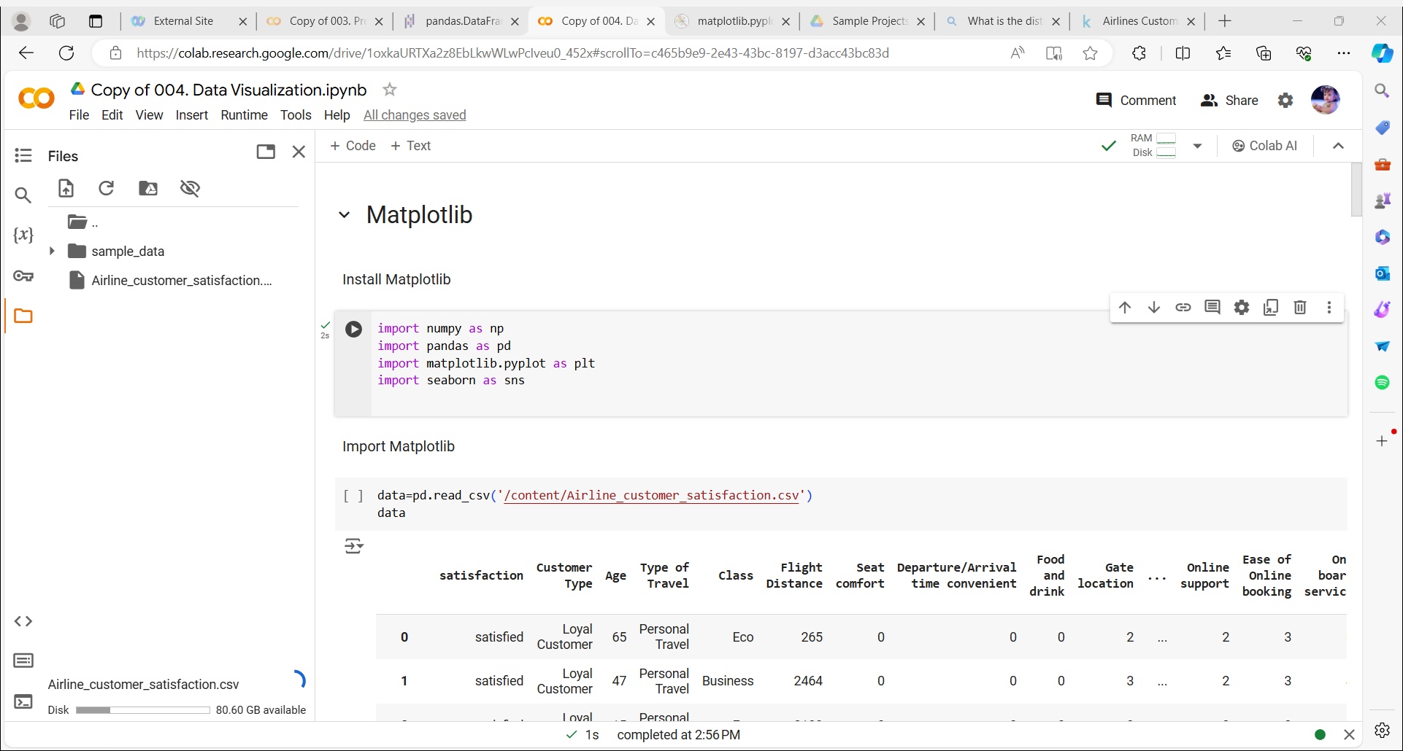
Importing necessary modules:
Pandas is a fast, powerful, flexible and easy to use open source data analysis and manipulation tool,
built on top of the Python programming language.
NumPy is a library for the Python programming language, adding support for large, multi-dimensional arrays and matrices, along with a large collection of high-level mathematical functions to operate on these arrays.
Matplotlib is a plotting library for the Python programming language and its numerical mathematics extension NumPy.
Seaborn is a Python data visualization library based on matplotlib. It provides a high-level interface for drawing attractive and informative statistical graphics.

Slide 7
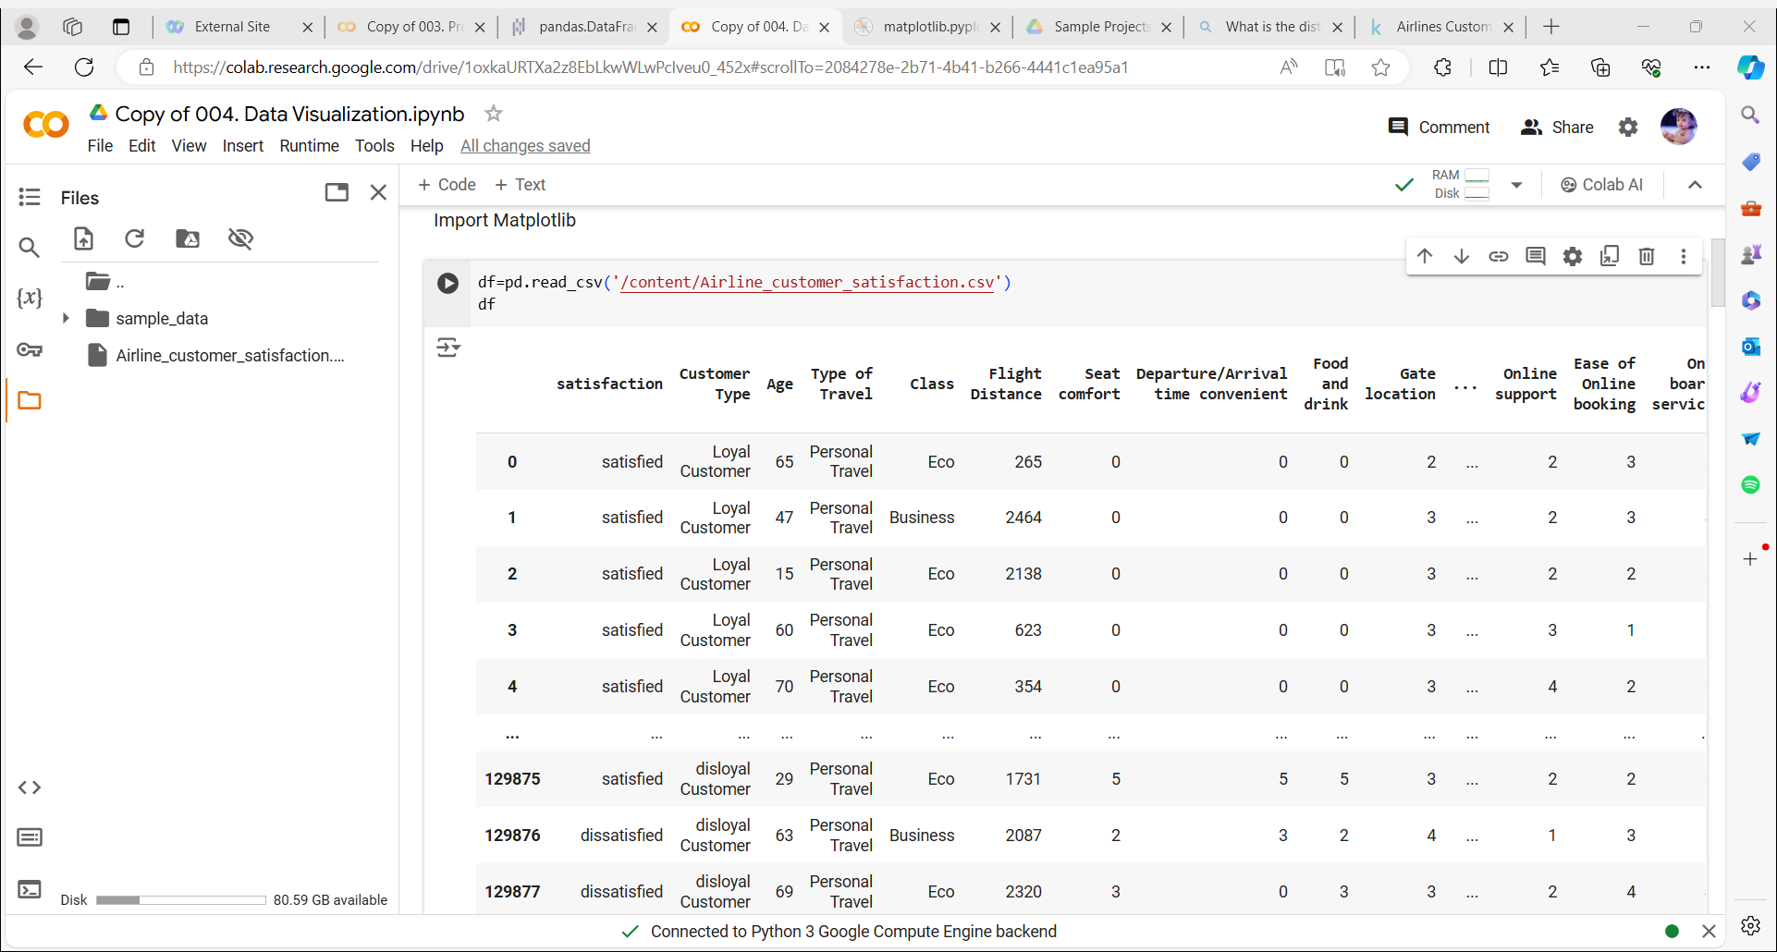
Load the dataset:

Slide 8
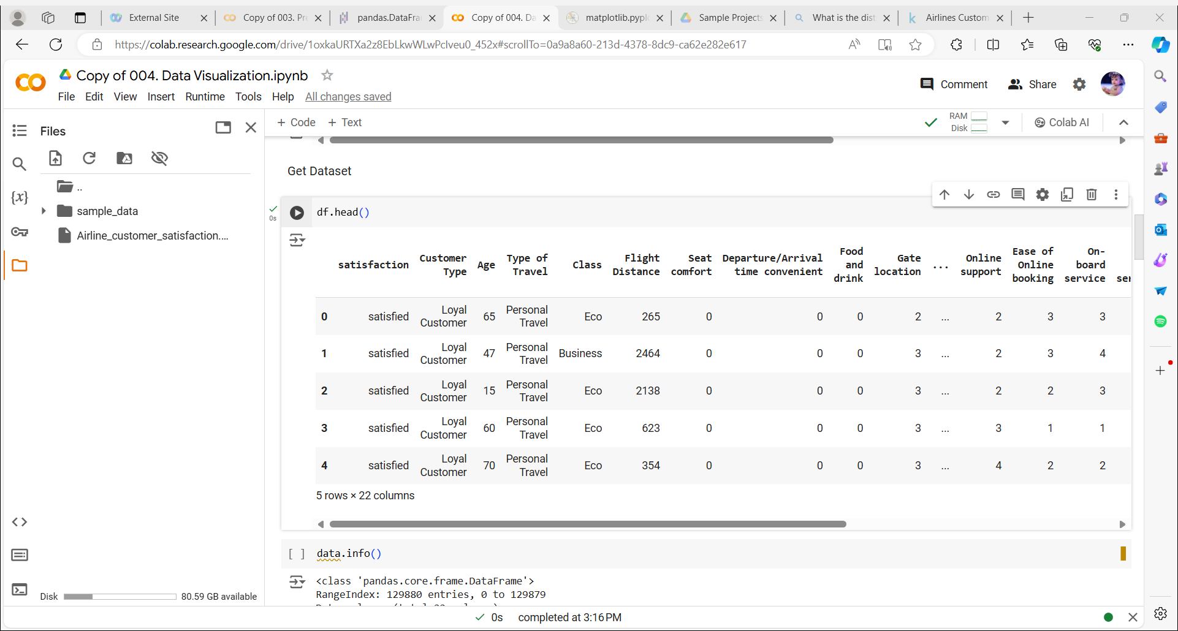
Data Exploration:

Slide 9
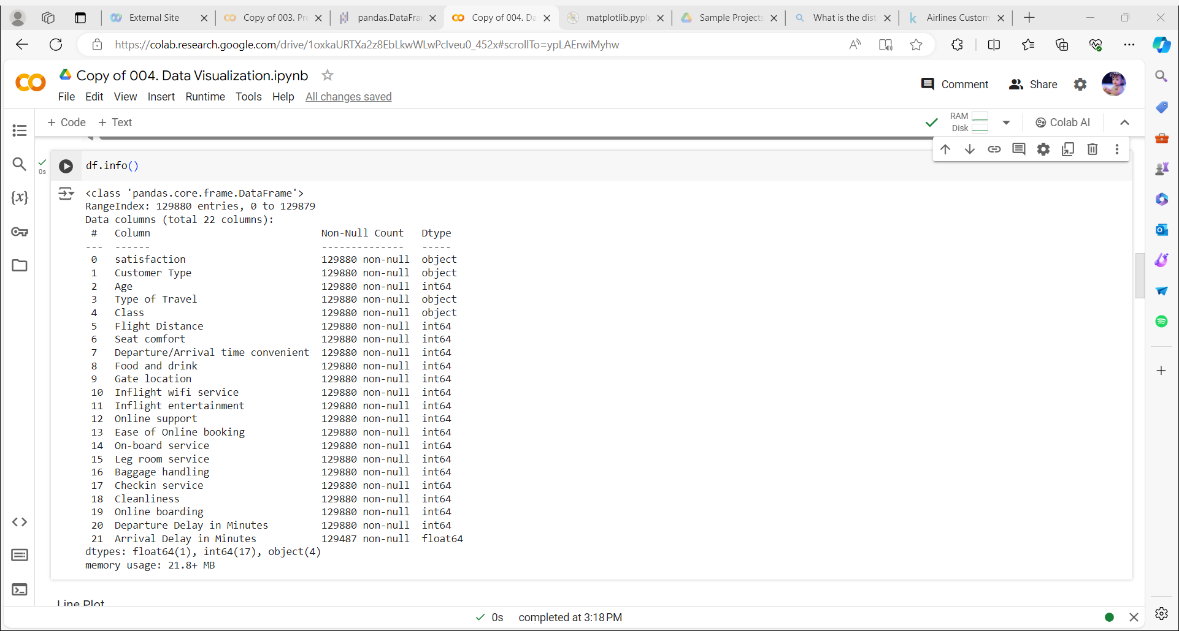

Slide 10
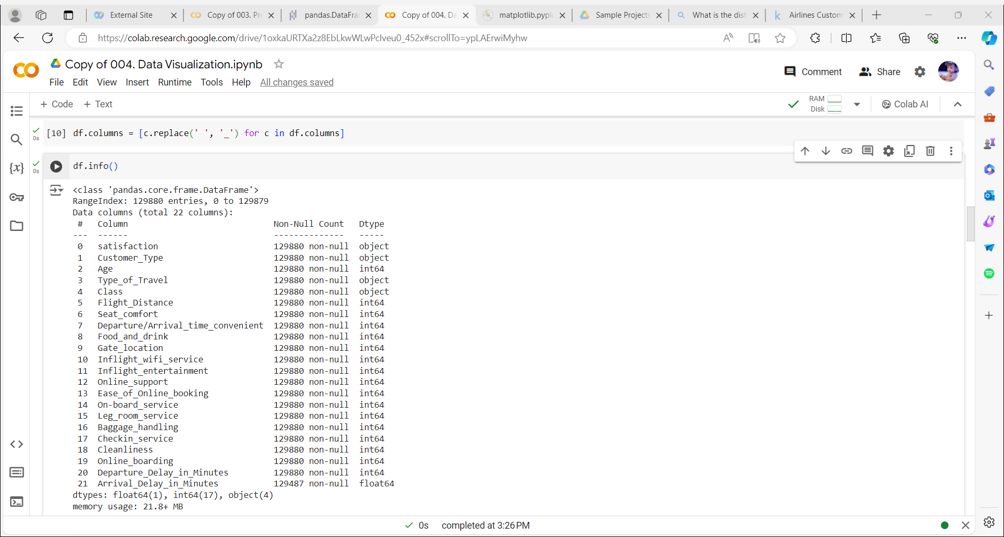
Changing the column names into right form :

Slide 11
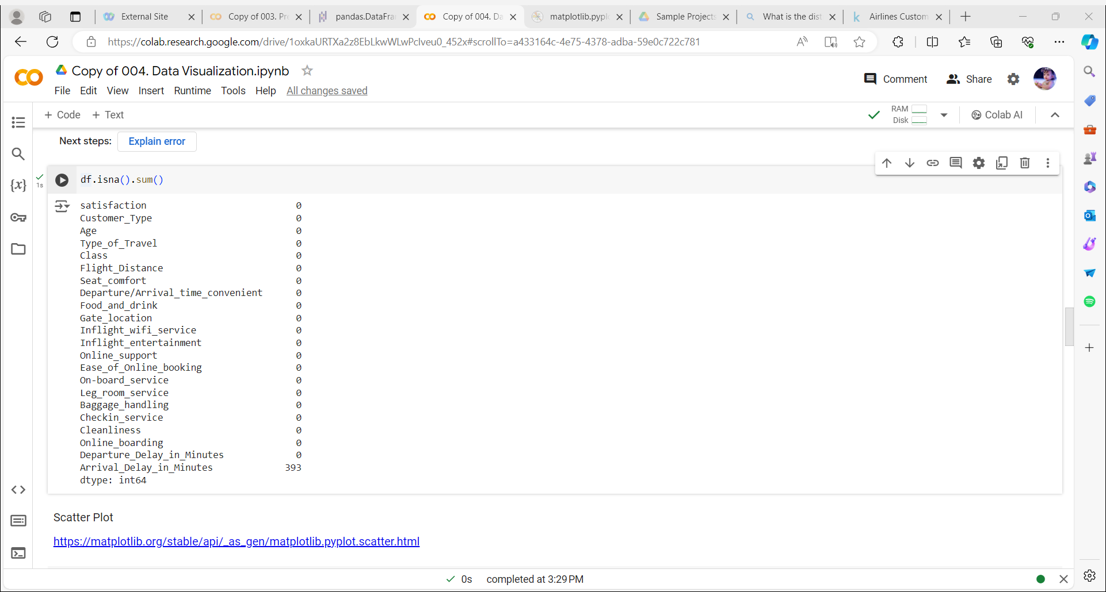
Checking for missing values:

Slide 12
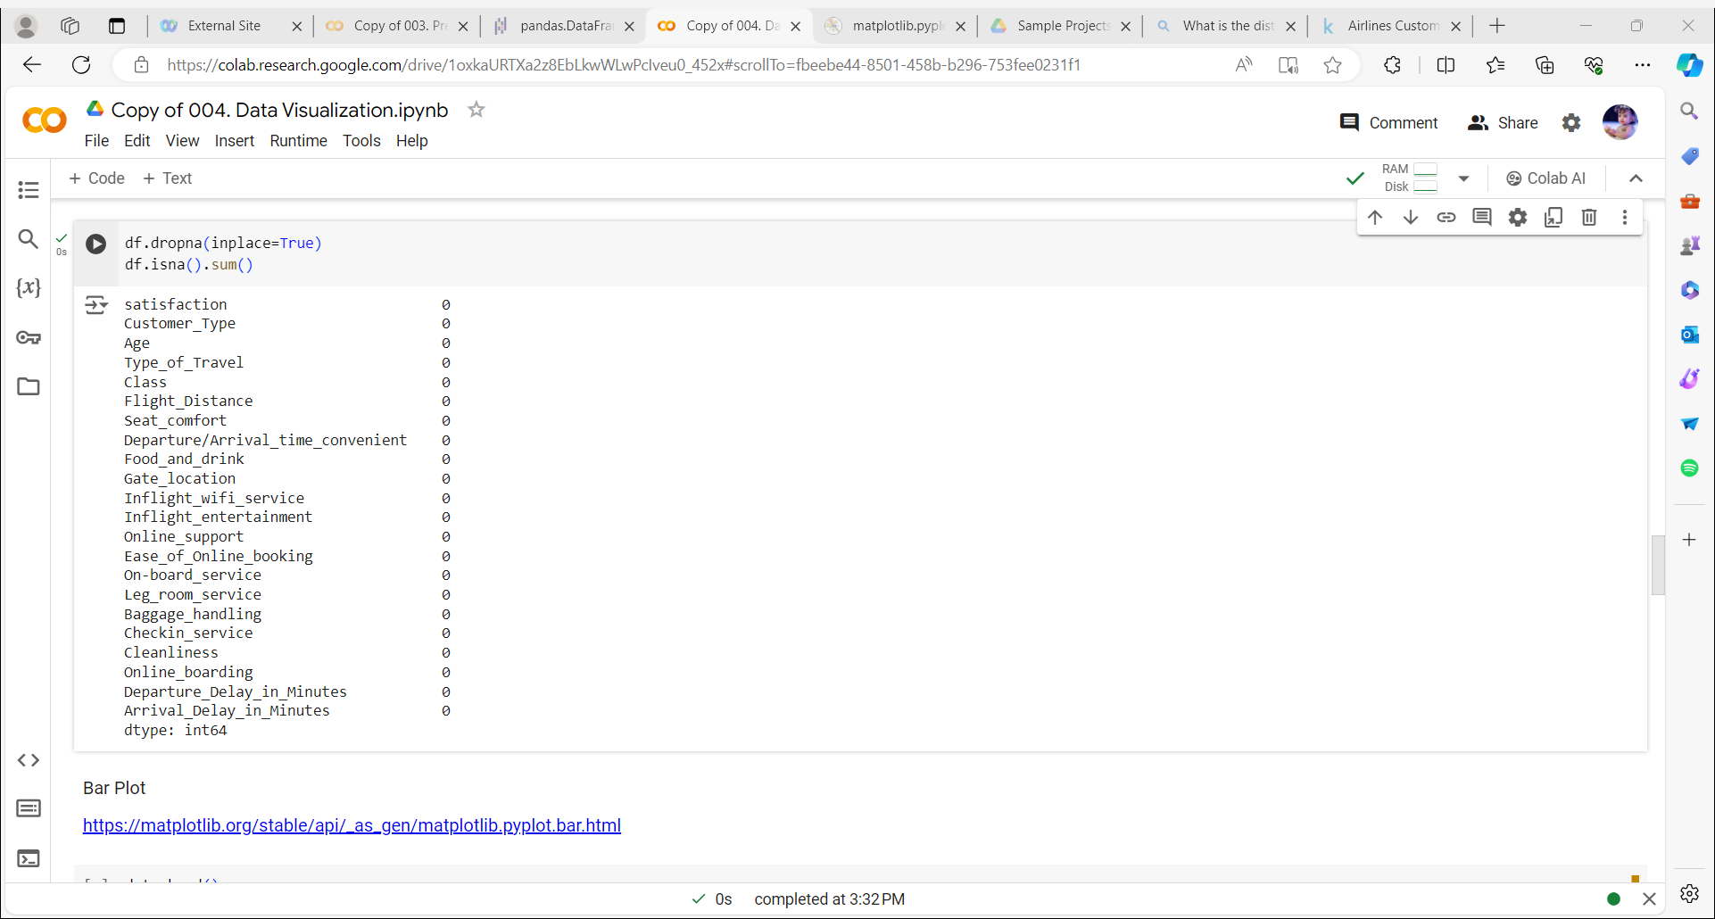
Deleting the missing value rows:

Slide 13
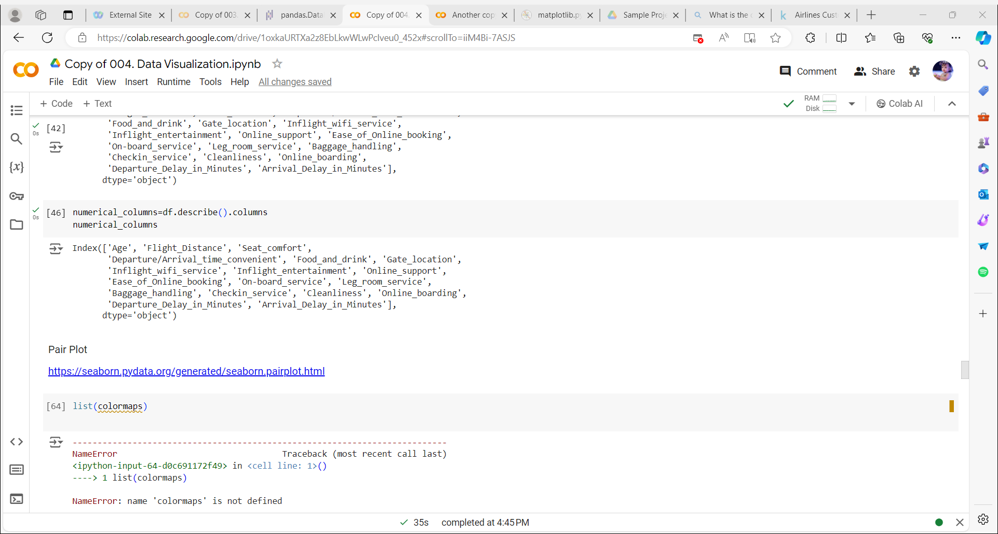
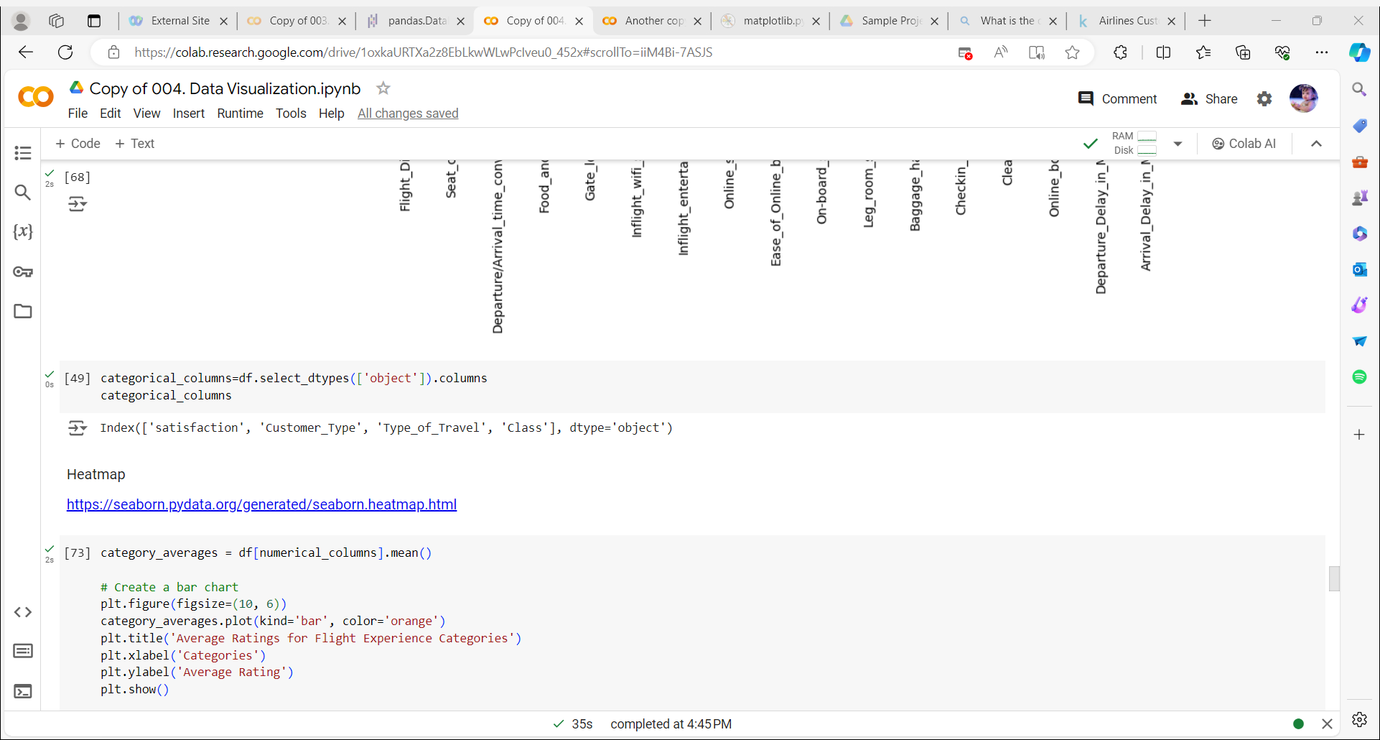
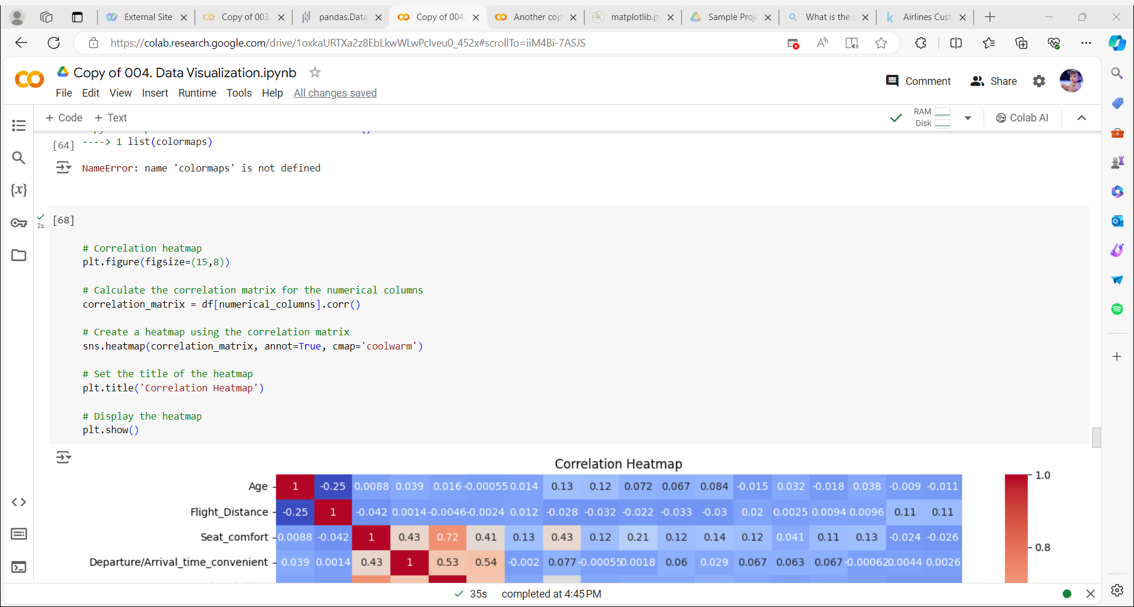
Continuous columns:
Categorical Columns:
Heat Map :

Slide 14
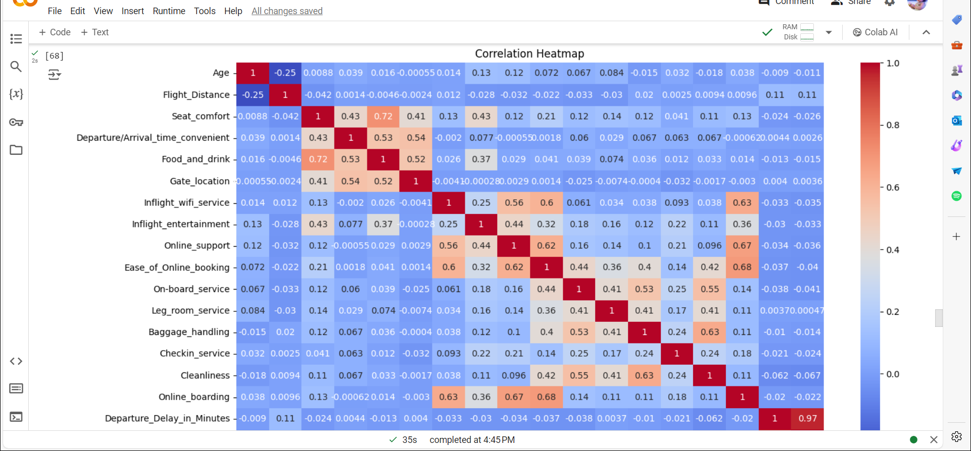
Creating heatmap for all continuous columns to find the correlation between them as, a result there is no much correlation between the columns

Slide 15
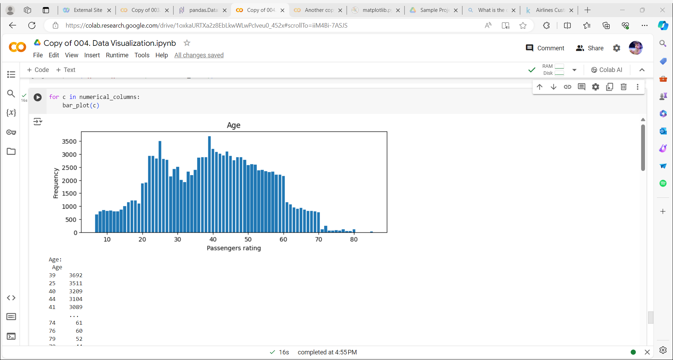
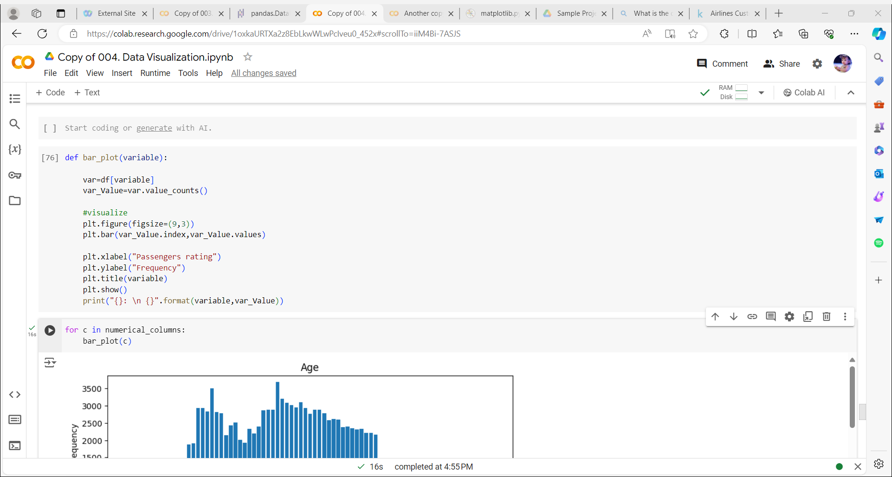
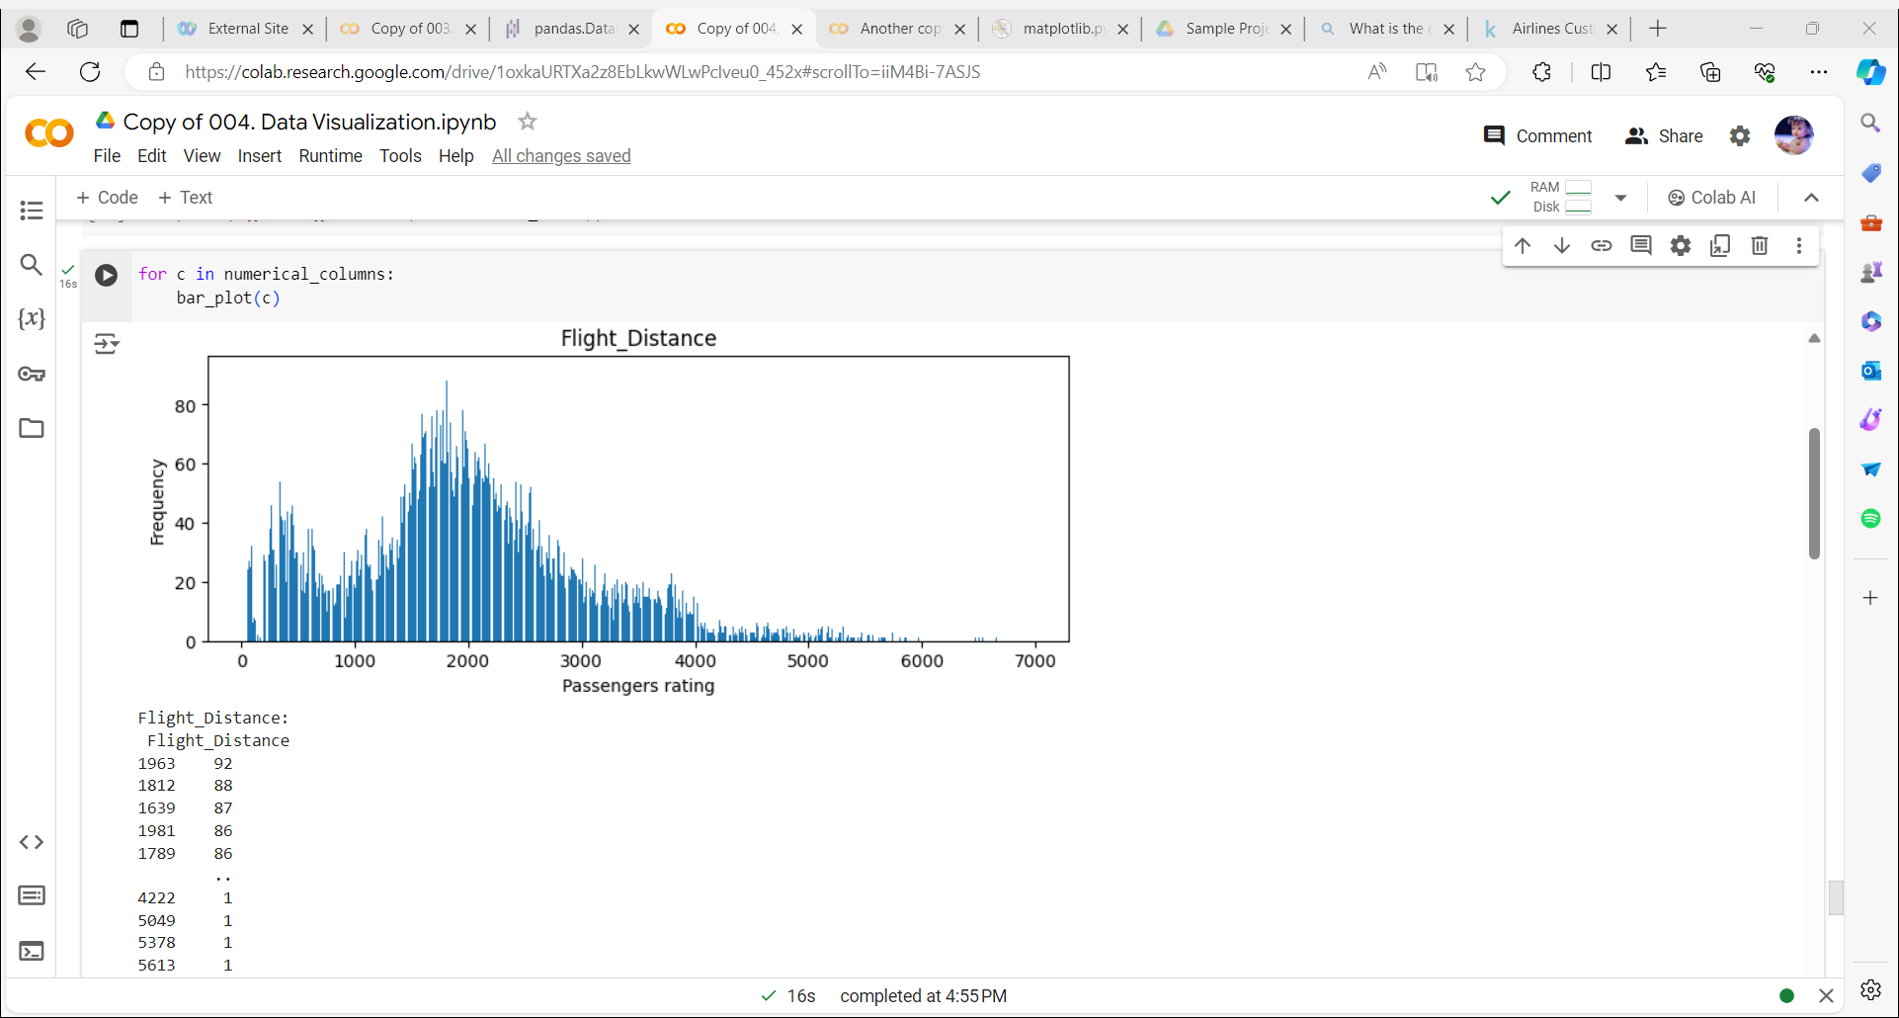
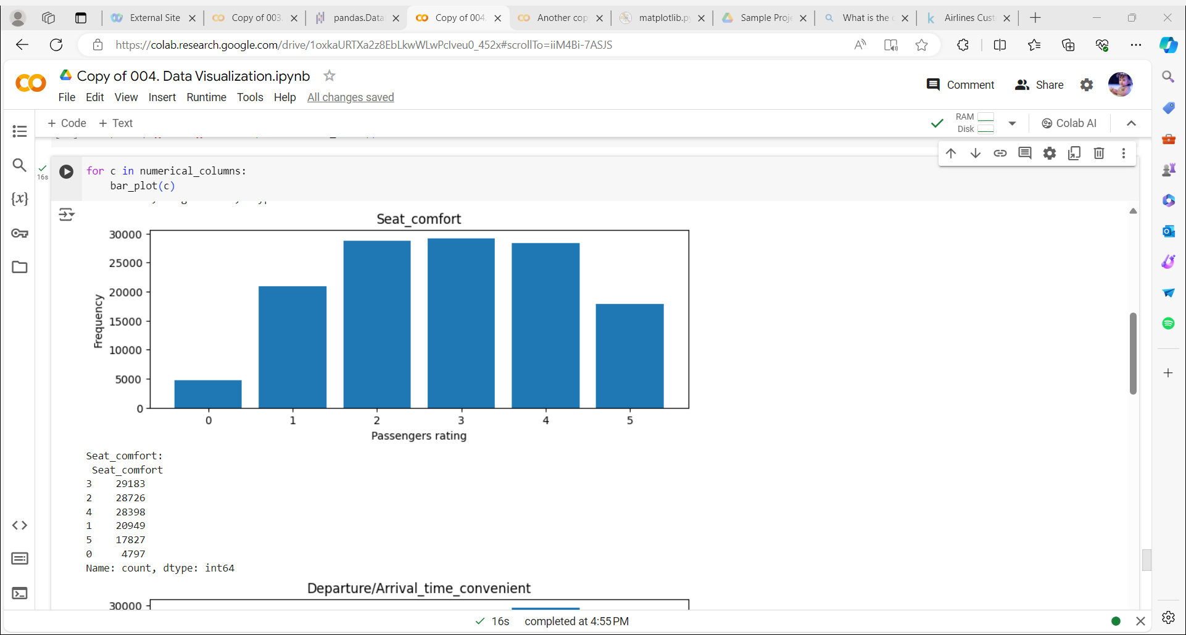
Bar Plot:

Slide 16
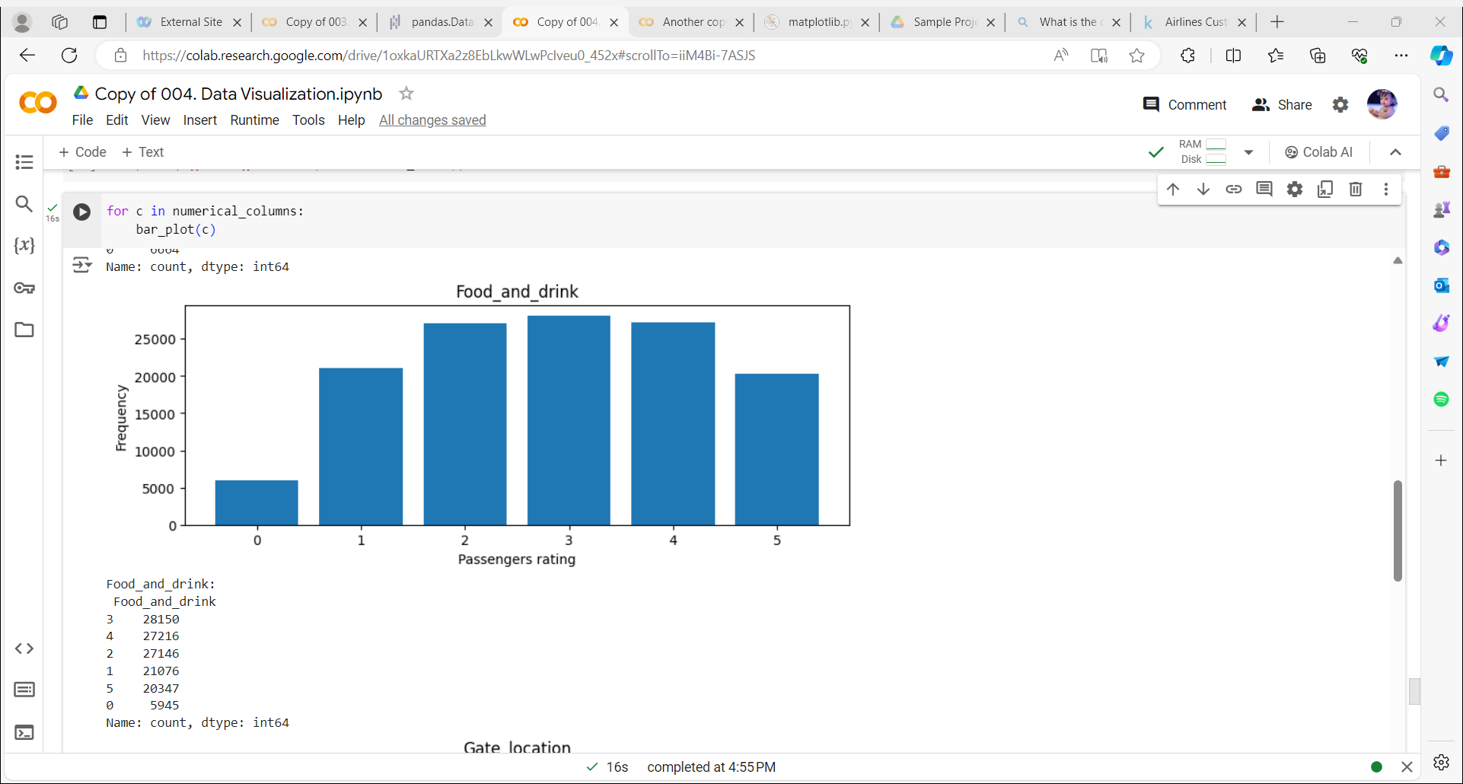
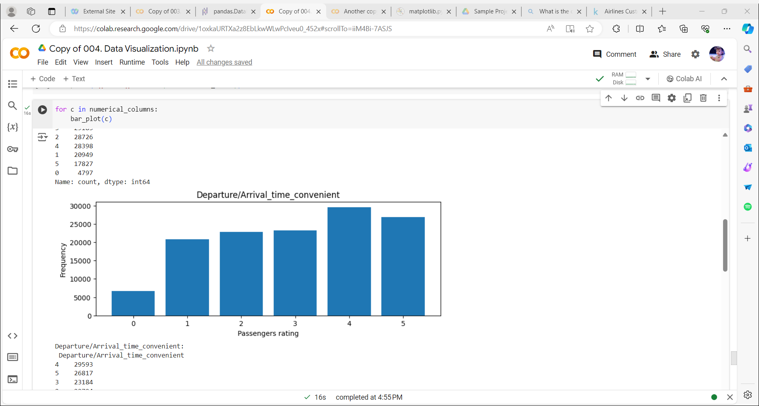
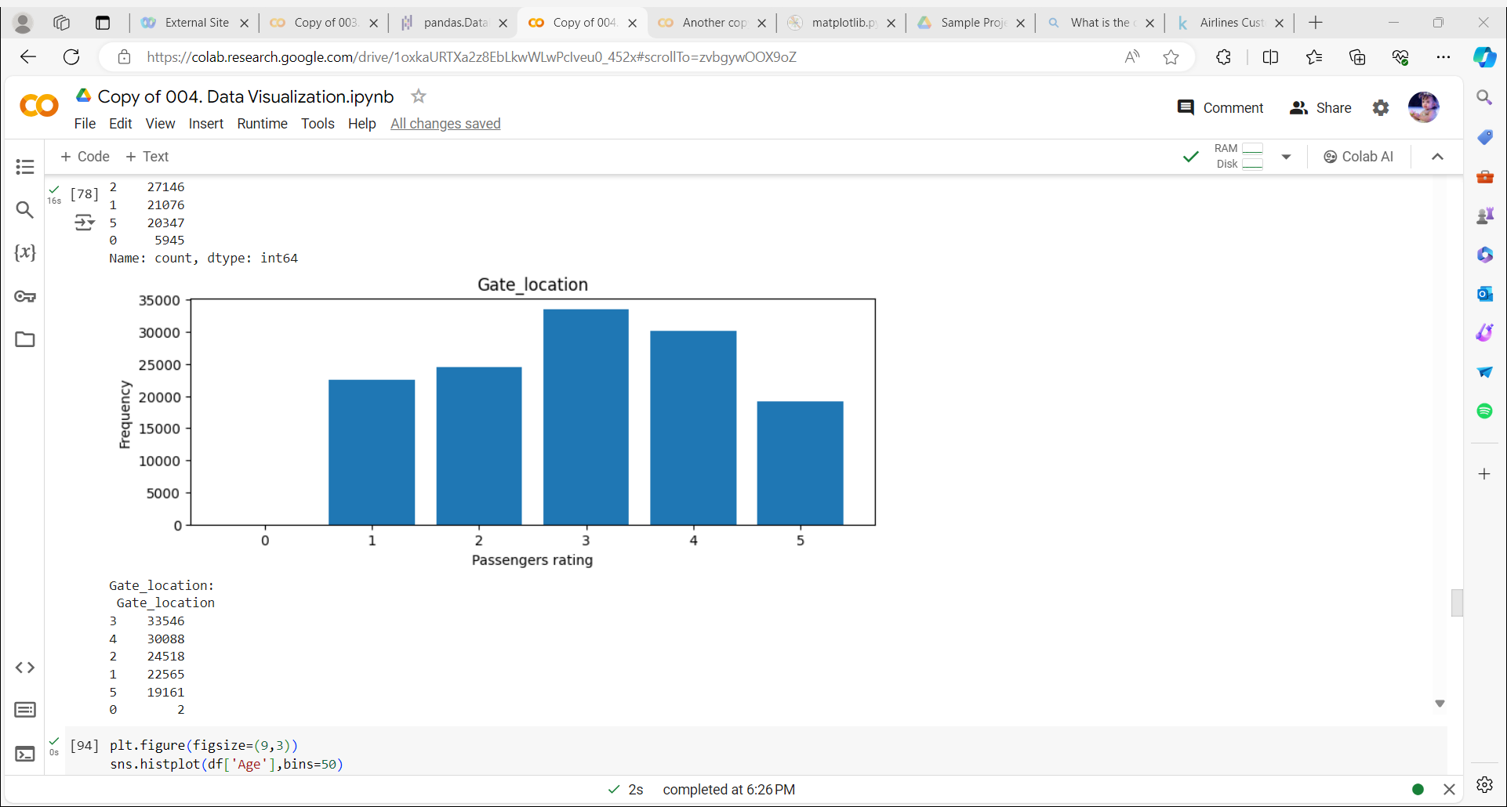
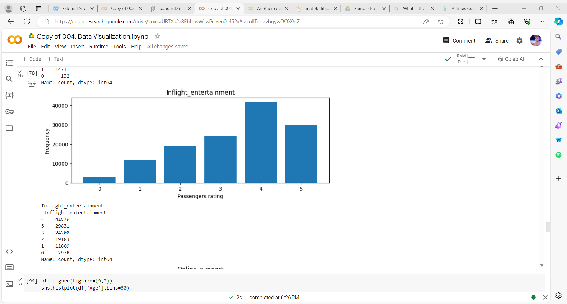

Slide 17
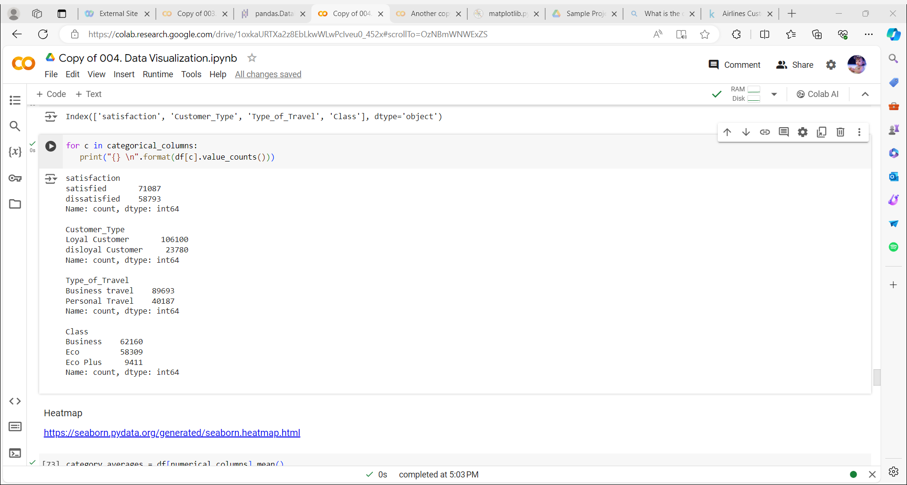
Count in Categorical variables:

Slide 18
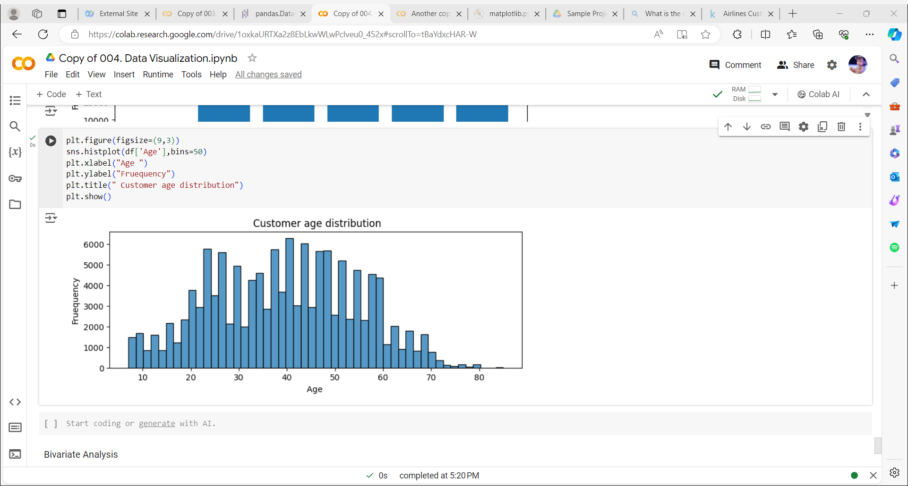
Customer age distribution:

Slide 19
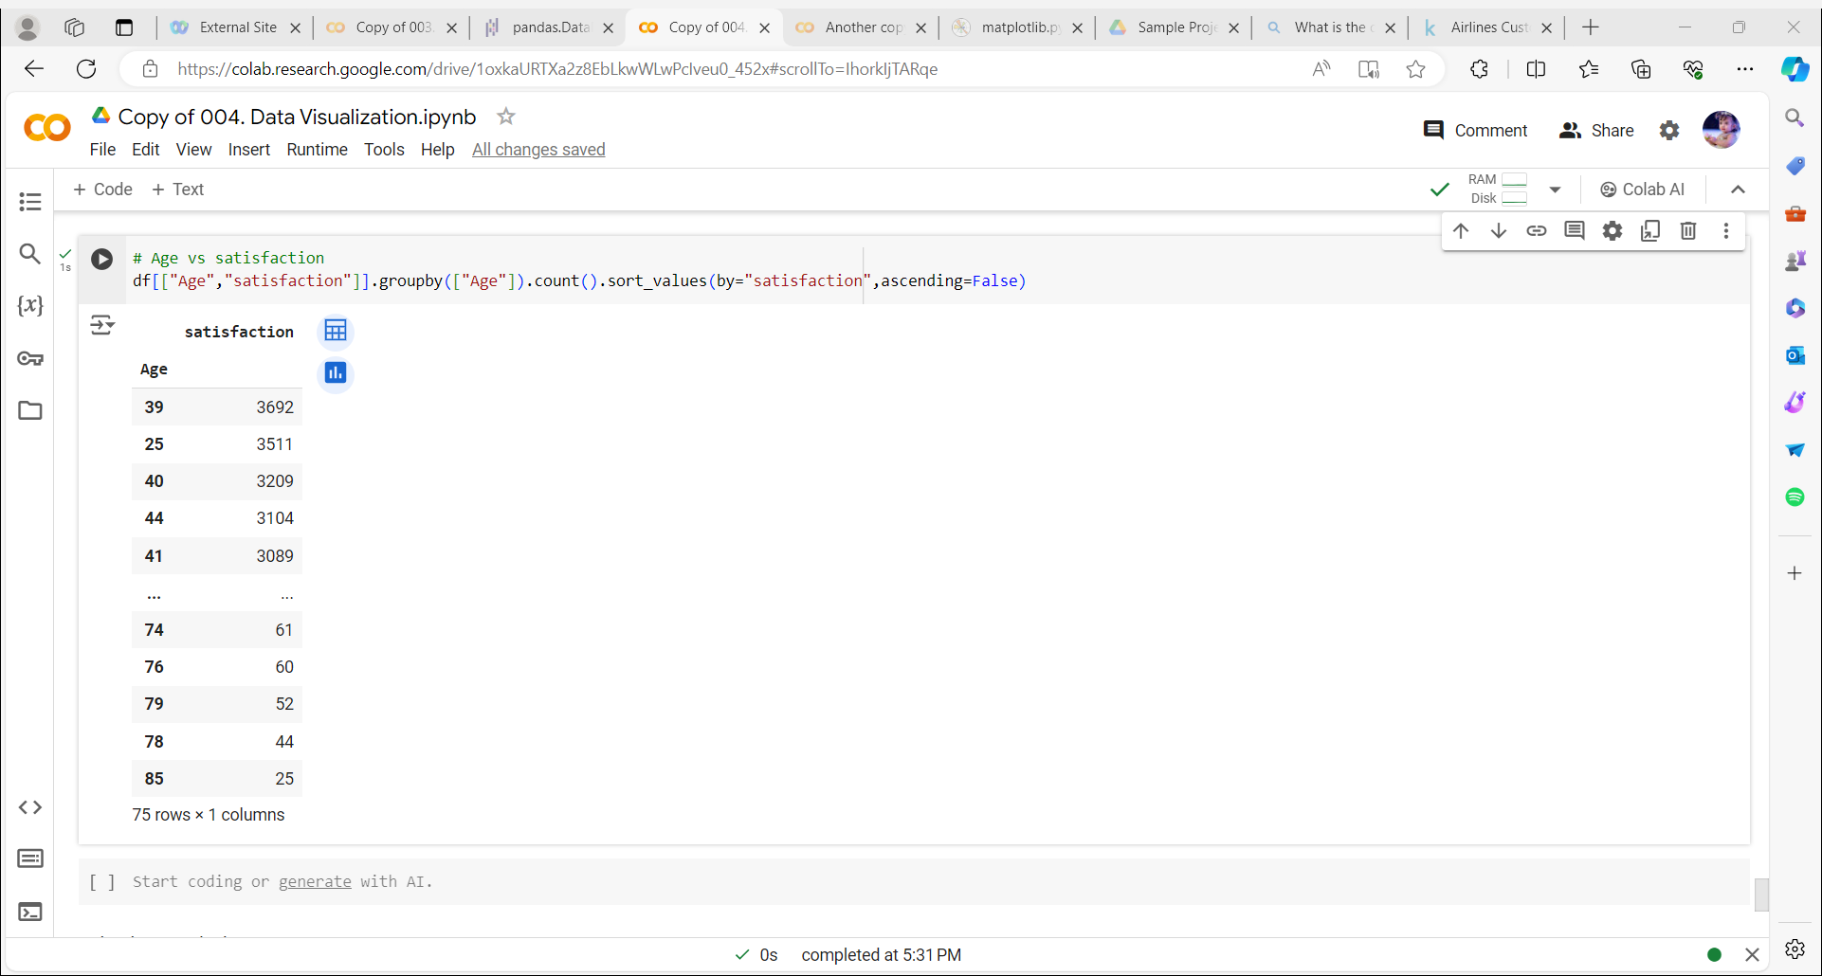
Which age group is more satisfied with airline services..
The conclusion ,age group of 30 to 40 are more satisfied with the airline services

Slide 20
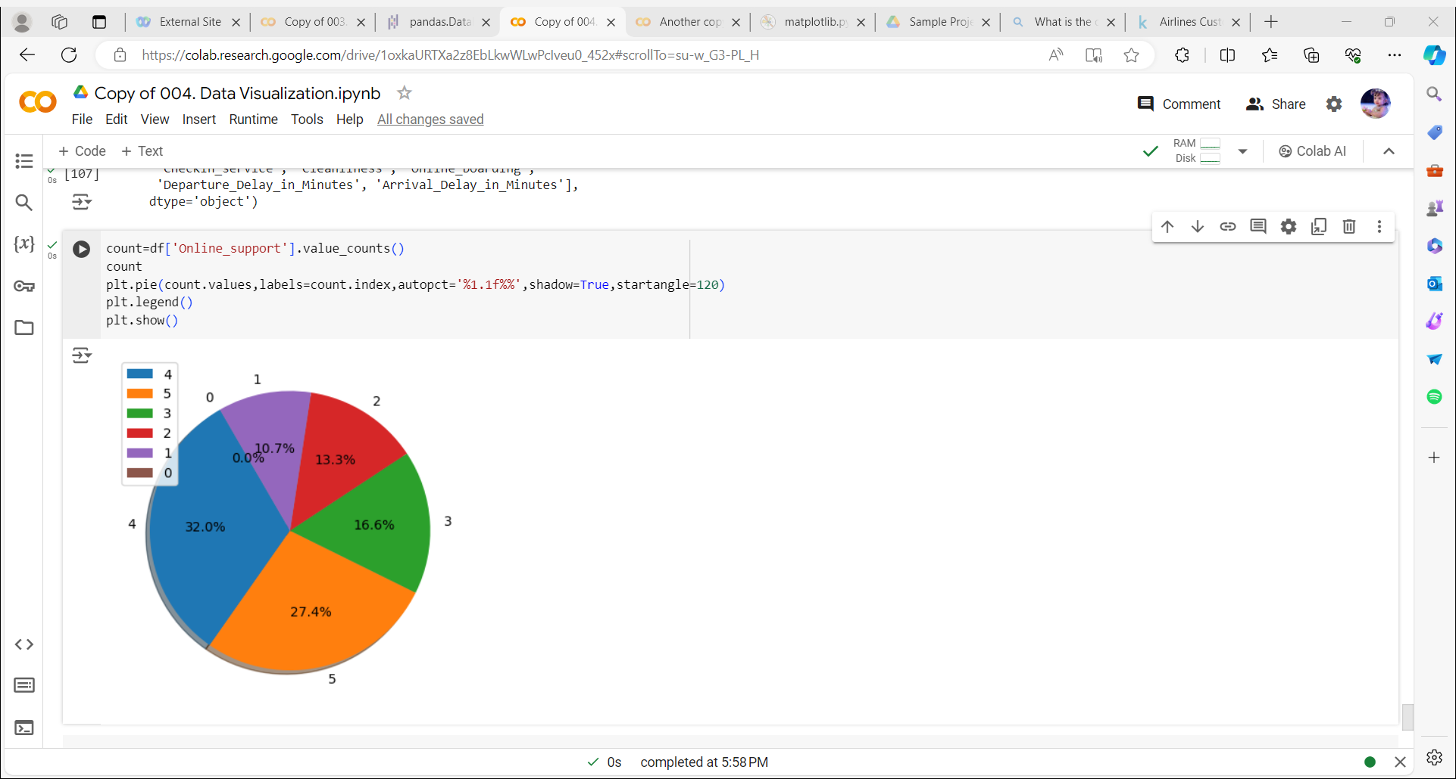
Rating to the online support:

Slide 21
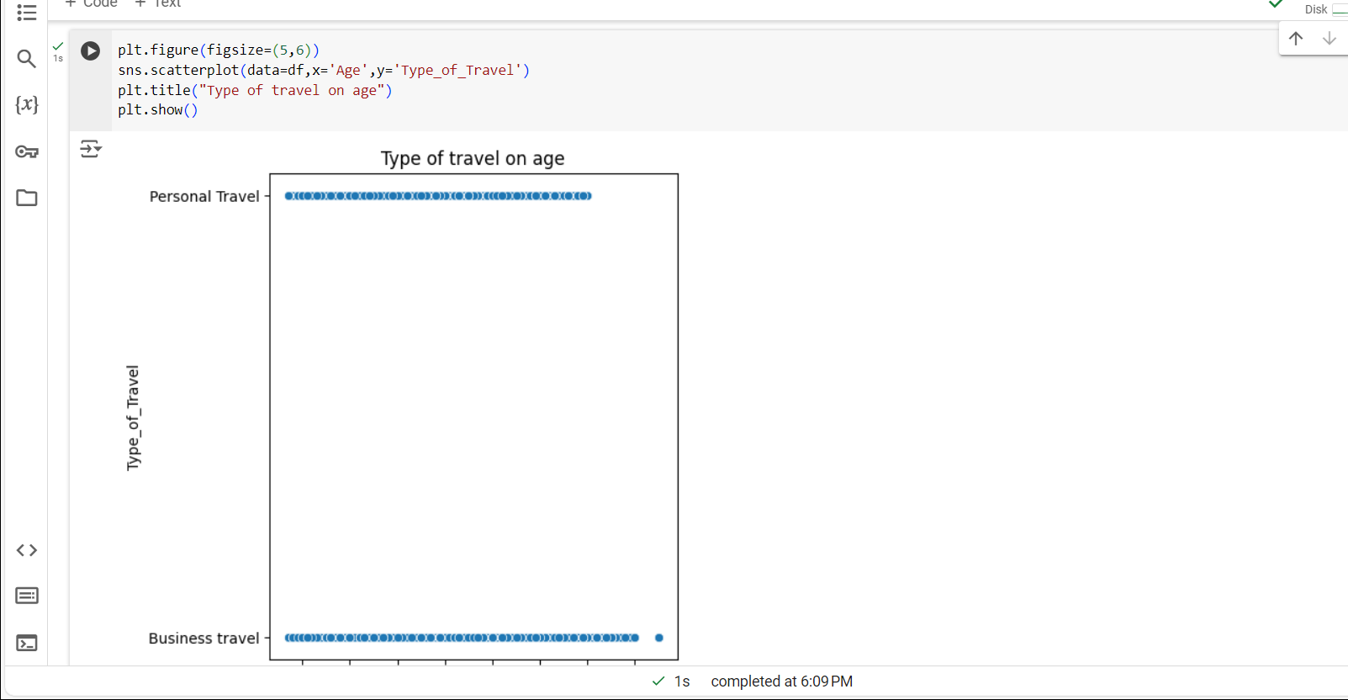

Slide 22
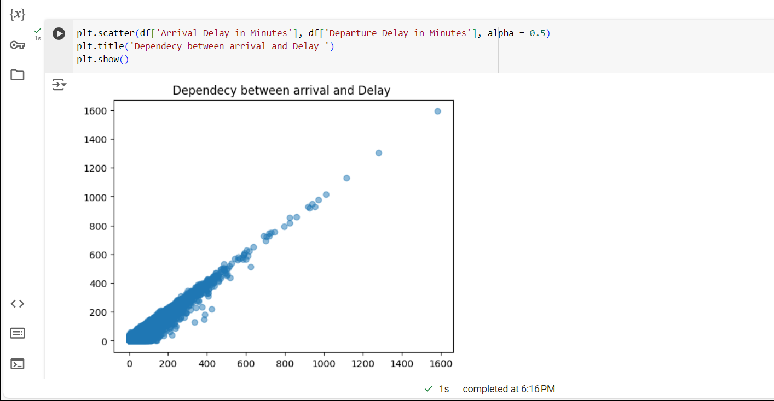
Hence, Arrival in minutes and departure delay in minutes both are linearly dependent. If it is arrived lately, then departure will be delayed

Slide 23
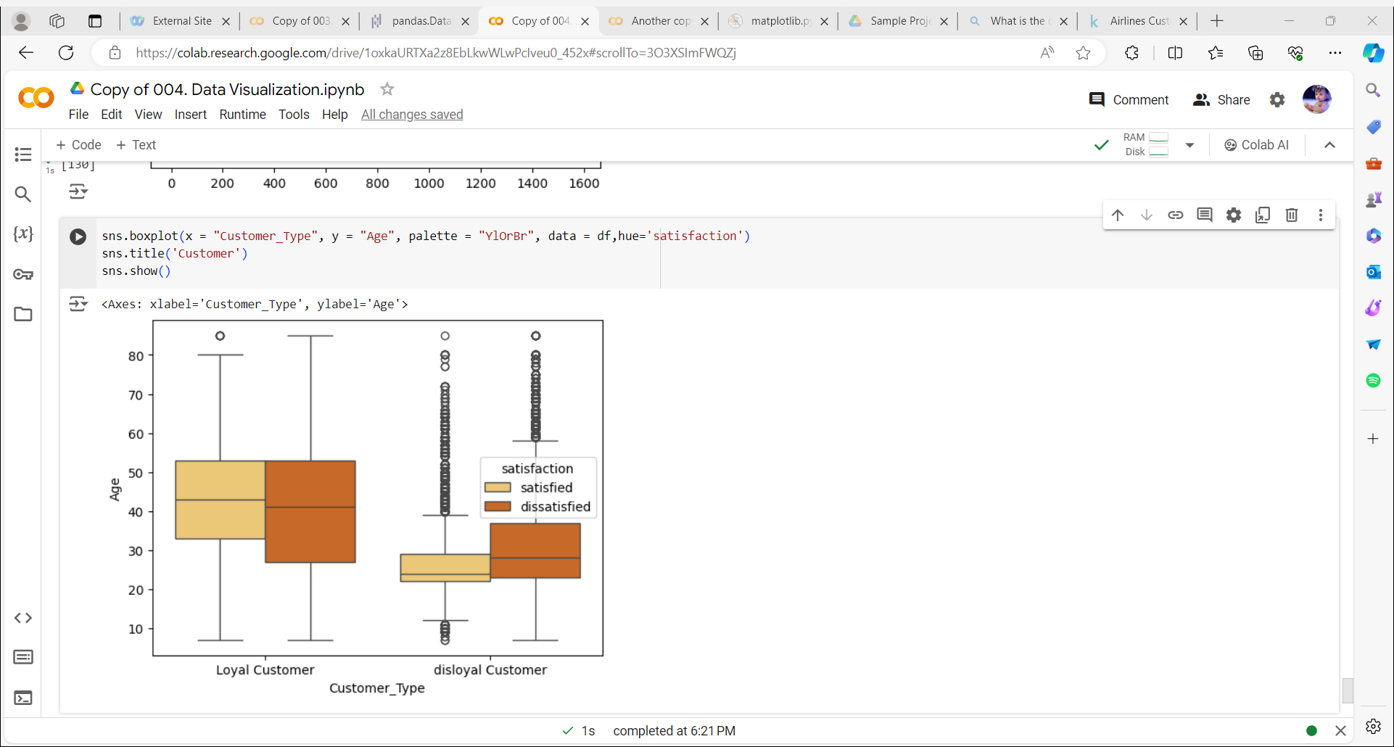

Slide 24
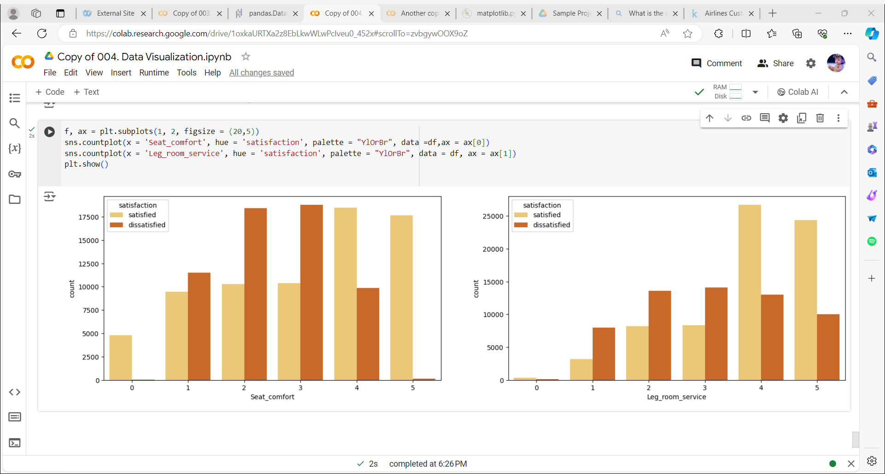

Slide 25
Conclusion:
More than 60% of passengers were satisfied with the luggage transportation service (rating 4-5 out of 5).
More than 50% of passengers were comfortable sitting in their seats (rated 4-5 out of 5).
There was a strong correlation (96%) between the features 'Departure delay in minutes' and 'Arrival delay in minutes' (which is quite logical and was discussed in detail above).
Most of the airline's regular customers are between the ages of 30 and 50 (averaging a little over 40). The age range for non-regular customers is slightly smaller (from 25 to 40 years old, with an average of slightly less than 30).
Customers whose flight distance is long tend to fly in business class.
The more distance an airplane passenger travels (respectively, the longer they are in flight), the more satisfied they are with in-flight entertainment and extra legroom (on average).

Slide 26
Thank You
“
”

